Slide 1


 | Nitte Meenakshi Institute of Technology (AN AUTONOMOUS INSTITUTION AFFILIATED TO VISVESVARAYA TECHNOLOGICAL UNIVERSITY, BELGAUM) PB No. 6429, Yelahanka, Bangalore 560-064, Karnataka Telephone: 080- 22167800, 22167860, Fax: 080 - 22167805
Department of Computer Science and Engineering
Project Title: Modernizing Food Ordering: Streamlining Canteen Systems for Efficiency and Safety
Group No. : 2
Presentation By:
SHREYA 1NT20CS167
SHREYA RANGARAJ 1NT20CS169
SOWMYA G 1NT20CS181
Guided By:
Guide: Mrs. Deepthi J. Shetty
Assistant Professor, Dept. of CS&E, NMIT
Mrs. Uma R.
Assistant Professor, Dept. of CS&E, NMIT

Slide 2
TABLE OF CONTENTS
 | Nitte Meenakshi Institute of Technology (AN AUTONOMOUS INSTITUTION AFFILIATED TO VISVESVARAYA TECHNOLOGICAL UNIVERSITY, BELGAUM) PB No. 6429, Yelahanka, Bangalore 560-064, Karnataka Telephone: 080- 22167800, 22167860, Fax: 080 - 22167805
Department of Computer Science and Engineering
ABSTRACT
PROBLEM STATEMENT
RESEARCH MOTIVATION
CLEAR OBJECTIVES
LITERATURE REVIEW (TABLE FORMAT).
DESIGN-FLOW CHART/USE CASE DIAGRAM/SEQUENCE DIAGRAM
SYSTEM REQUIREMENTS
IMPLEMENTATION
RESULT
CONCLUSION
REFERENCES

Slide 3
1.Abstract
In today's dynamic dining landscape, the need for efficient, secure, and user-friendly food ordering systems has never been more critical. This project presents a cutting-edge Canteen Food Ordering System (CFOS) built on the Django framework, seamlessly integrated with PayPal for secure online payments.
CFOS empowers customers with a user-friendly web and mobile application that facilitates intuitive menu navigation, customization of orders, and secure payments through PayPal integration. Moreover, the system incorporates safety measures, such as contactless ordering and payment, to address the growing concern for public health.
For canteen administrators and staff, CFOS offers a robust order management system that streamlines order processing, minimizes errors, and reduces wait times. Real-time order tracking enhances efficiency, while data analytics provide valuable insights for menu planning and resource allocation.
This system represents a vital advancement in the food service industry, contributing to improved efficiency, safety, and overall customer satisfaction.

Slide 4
2.Problem statement:
Traditional food ordering systems in educational institutions and workplaces rely heavily on manual processes and physical queues, leading to inefficiencies and potential health risks, particularly in the context of the COVID-19 pandemic.
Long waiting times, overcrowding, and a lack of digitization exacerbate these problems. This research aims to address these issues by investigating and implementing modern approaches that streamline canteen systems.
The objective is to create an efficient, contactless ordering process that reduces wait times and enhances safety.
By identifying innovative technologies and methodologies, we intend to propose practical solutions that significantly improve the food ordering experience, ensuring a seamless, secure, and user-friendly environment within canteens.

Slide 5
3.Research motivation
The motivation for this research stems from a critical need to address the inherent inefficiencies and safety concerns prevalent in traditional food ordering systems, particularly within school and workplace canteens.
The COVID-19 pandemic highlighted the vulnerabilities of these systems, necessitating a reevaluation and modernization to prioritize efficiency and safety.
By embracing technology and innovative approaches, we can optimize the ordering process, reduce waiting times, minimize physical contact, and enhance overall user satisfaction.
This research seeks to explore contemporary solutions that leverage advancements such as mobile applications, cloud computing, and contactless payments to revolutionize canteen systems, aligning them with the demands of a fast-paced, technology-driven world.

Slide 6
4.Clear objectives
The research objectives are to modernize food ordering systems in canteens, focusing on enhancing efficiency and safety.
Firstly, to assess current canteen operations, identifying bottlenecks and safety concerns.
Secondly, to develop and implement a user-friendly digital ordering platform that streamlines the ordering process.
Thirdly, to integrate contactless payment options and digital menus to reduce physical interactions.
Fourthly, to evaluate the impact of these changes on order processing times and customer satisfaction.
Lastly, to establish safety protocols, including food handling and hygiene measures, to ensure a safe dining experience. The goal is to create a more efficient and secure canteen environment through technology and improved practices.

Slide 7
5.Literature Survey
PAPER TITLE - AUTHORS | YEAR OF PUBLICATION | OBSERVATION | GAP IDENTIFIED
1.Smart Cafeteria Management System using Neural Networks By Ramya Gorantla | December 2022 | This system allows customers to register and visit the cafeteria at their convenience while ensuring they are billed accurately. | The future scope of the work is planned by implementing biometrics of the customer along with face recognition available in the existing system.
2.Canteen Food Ordering and Management Application Nur Syazwani Zul1 , Nur Ariffin Mohd Zin. | October 2022 | The purpose of developing this application is to help parents to place orders on behalf of their children in order to avoid overcrowding at the canteen. Agile-based methodology is used as the methodology to develop this application. | payment delay due to system overload

Slide 8
3.SmartMeal: A scalable catering application Mohamed-Ata-Radu Abu Ras, Paul Stefan Popescu, Mihai Mocanu, Marian Cristian Mihaescu. | 2022 | The application's audience is not limited and can be easily used by any company that regularly demands meals.This application uses a mix of frameworks, programming languages, and technologies to provide all the required functionalities and run on desktop computers and mobile devices. | In future work, a system evaluation shall be performed to better understand the users' needs and punctually improve the interface.
4.Canteen Ordering System with Daily Update of Calorie Consumption Report using Cloud Computing Diksha Jagtap, Ashwini Kokate, Nisha Gupta, Seema Raysingh, Manjiri Pathak. | 2023 | The objective of the Canteen order website is to overcome the disadvantages of traditional ordering system. It provides Calorie consumption report of customer, more flexibility, and reliability. | no limitations

Slide 9
5.AUTOMATED CANTEEN ORDERING SYSTEM ABUBAKKAR SK DANIYAL, AKHTAR MOHAMMAD ARSHAD KHAN, Rani astya | 2020-2022 | This system offers a user-friendly interface where customers can easily order from a diverse menu, make payments via credit card or wallet, and receive food recommendations and trending items. Users are required to register with valid details and an OTP sent to their mobile number for login security. The system manages food item details, including names, descriptions, images, and prices. | It can select the current location of the user but by using current location it cannot detect the university or campus. User do not get auto email for order confirmation There is no tracking system for food preparation only a predicted time.
6.CANTEEN ORDERING SYSTEM USING ANDROID Shubhra Masurkar, Akanksha Dhagadi, Yogesh Kulkarni, Amit Aylani | 2022 | They are developing an app on which a user would be able to place an order and pay via e-walletor UPI. The request for the order would be displayed in canteen where the order would be accepted. | The developer can also usebiometrics for customers and admin to log-in the application like this will be veryhelpful for future generation.

Slide 10
7.Smart Cafeteria Sasirekha N Associate Professor, Sona College of Technology, Salem, Tamil Nadu Shreenivas K M UG student | 2023 | In this application, people can order food online using sites, once they have paid for food, they can get the order id or booking id. | no limitation
8.Web based E- wallet Canteen Management System using RFID Giteshri Kale1, Sharad Dube2. | 2021 | Utilizing web-based software and Radio Frequency Identification (RFID), this system can be accessed from anywhere with an internet connection, providing error-free accounting, cost-effectiveness, security, reliability, and rapid service management. | This project has a very vast scope in future. The project can be implemented completely on internet. Online food ordering system can be updated in near future as and when requirement for same arises, as it is very flexible in terms of expansion. So that hardware system will not require. It reduces time and effective cost. In this project we can develop mobile application for user. So that through online order system food can be prepared earlier before reach to canteen.

Slide 11
9.Online Food Ordering System for College Canteen Rupali B. Kale* , Ruchika K. Balwade, Vipin B. Gawai. | 2021 | The aim of the online food ordering for the college canteen is to automate the current manual system with the help of electronic equipment and full-fledged computer software, fulfilling their needs, so their valuable data will be kept for an extended amount with straightforward accessing and manipulation of identical | no limits
10. Canteen Automation System with Payment Gateway | 2022 | It is has been observed that the canteen/ mess/ cafeteria that we manifest in our day to day lives, while in a institution like educational, business or government driven has many drawbacks such as long serpentine queues, congestion due to the rush in peak hours etc.we propose an automated system which would surpass the current hassle by an automated web based system which will maintain, manage and process orders of customers in a speedy way using a website and its stored database. | system lag

Slide 12
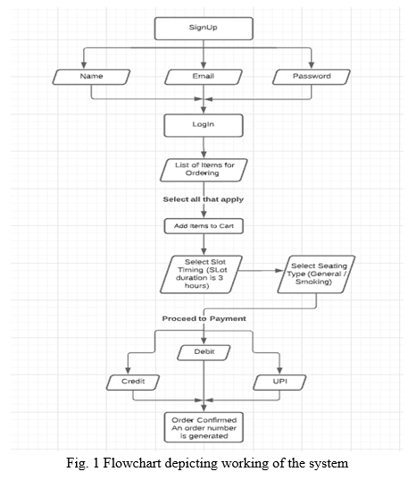
6.DESIGN-FLOW CHART/USE CASE DIAGRAM/SEQUENCE DIAGRAM

Slide 13
7.SYSTEM REQUIREMES
Functional Requirements:
Customers: 1. Sign Up (only for new customer) Input: “SignUp” option selected. Output: customer prompted to enter the details.
2. Login Input: “Login” option selected. Output: customer prompted to enter the username and password.
3. Forgot password Input: “forgot password” option selected. Output: customer prompted to enter the email and new password.
4. Select food items State: The customer has logged in and the main menu has been displayed. Input: Items are selected customer feel free to order. Output: System will display selected items.
5.Changes to order Input: “go to cart” option selected. Output: customer can delete or add food item in order.
6. Review the order before submitting Input: “Order Place” option selected. State: Customer name, phone number, location (address) display or enter the all of information. Output: customer prompted to pay the bill.

Slide 14
7. Payment State: The different types of payment method are display. Input: choose any payment method. Output: customer prompted to enter the verification code if choose online payment. State: Display order no., payment details and confirmation of delivery.
8. Logout Input: “Logout” option selected. Output: you are successfully logout. State: System display login page.
Employees:
Login (Employee login page) Input: “Login” option selected. Output: Employee prompted to enter the username and password.
2. Modify Menu State: In the system all the items are displayed with their rates. Input: “Change” option selected. Output: Employee can make changings in menu like adding or removing food items which are not available and changings rate of items.
3. Order list Input: “Order list” option selected. State: System display all order details. Output: Employee can make changings like confirm order, prepared order, delivered order, not confirm order.
4. Logout Input: “Logout” option selected. Output: you are successfully logout. State: System display login page

Slide 15
Administrators:
➢ Administrators must be able to use Employees all features.
Login (admin login page) Input: “Login” option selected. Output: admin prompted to enter the username and password.
2. Logout Input: “Logout” option selected. Output: you are successfully logout. State: System display login page.
Non-Functional Requirements:
Portability System running on one platform can easily be converted to run on another platform.
2. Reliability The ability of the system to behave consistently in a user-acceptable manner when operating within the environment for which the system was intended.
3. Availability The system should be available at all times, meaning the user can access it using a web browser, only restricted by the down time of the server on which the system runs.
4. Maintainability A commercial database is used for maintaining the database and the application server takes care of the site.

Slide 16
5. Security Secure access of confidential data (customer information).
6. User friendly System should be easily used by the customer.
7. Performance Performance should be fast.
8. Efficient System should be efficient that it won’t get hang if heavy traffic of order is placed.
9. Safety Data in the database of system should not loss or damage.
10. Privacy Personal data of the system should not disclose to anyone

Slide 17
8.IMPLEMENTATION
1.User module
The main aim of the User Module is provide all the functionality related users.It track all the information of the customers. We have developed all type of operations of the customers.This is role based Module Where Admin can perform each and every operations on data but customer only view his/her data, so access level restrictions has also been implemented on the project.
2.Product Module
The main purpose for developing the Product Module is to manage Products category wise. All product will be managed by admin and Customer will be able to see product and buy them. Admin can see the list, change product details and also add or delete products.
3.Order Module
The main aim of the Order Module is receive all order details and display them. It is designed to be used only by restaurant employees (and admin), and provides the following functions: Retrieve new orders from the database and Display the orders in an easily readable, graphical way. Under “ViewOrder” a customer will be able to see only his/her order.

Slide 18
4.Order Status Update Module
The main aim of this Module is update all information related to order. Admin or employee can change or add order status. Customer only see his/her order status details. Under “Tracker” a customer will be able to see his/her order all status details.

Slide 19
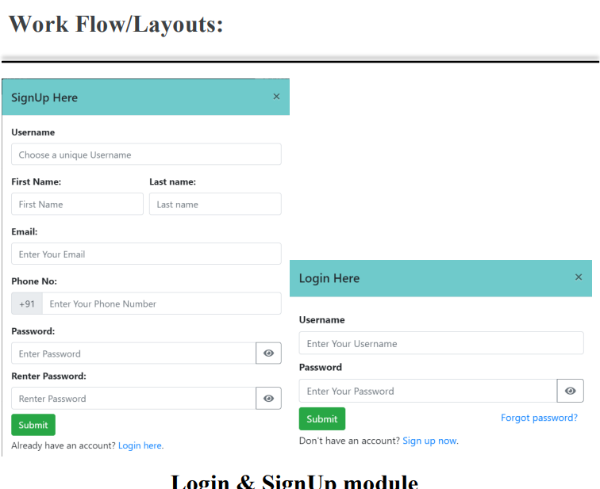
9.RESULT

Slide 20
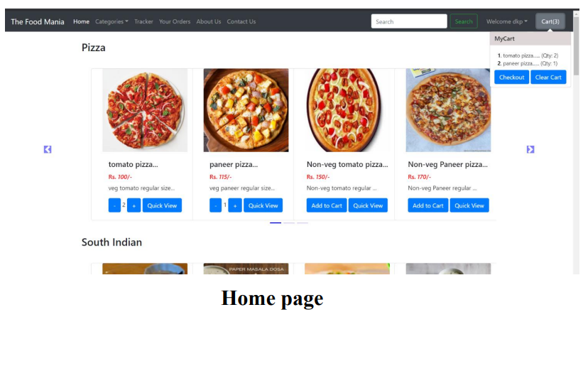
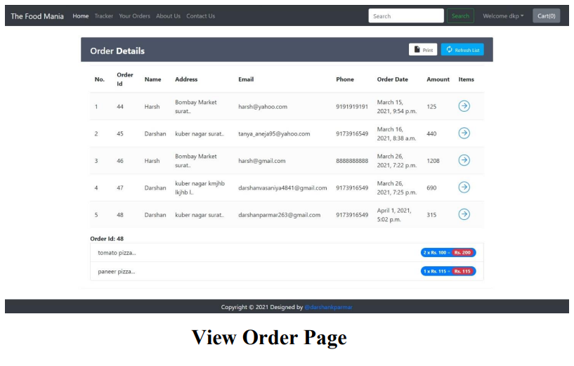

Slide 21
10.Conclusions
In conclusion, modernizing food ordering systems in canteens is essential for enhancing efficiency and safety.
By leveraging technology and digital solutions, we can streamline the entire process, reducing wait times and minimizing human contact, thus improving safety in a post-pandemic world.
Implementing mobile apps, self-service kiosks, and online ordering platforms not only offers convenience to customers but also enables canteen operators to manage inventory and operations more effectively.
Embracing these innovations is a win-win solution that not only meets the evolving needs of customers but also ensures the longevity and success of canteen businesses in the modern era.

Slide 22
11.References
[1] Smart Cafeteria Management System using Neural Networks By Ramya Gorantla December 2022 ,California State University, Northridge.
https://scholarworks.calstate.edu/downloads/nz806608w
[2] Canteen Food Ordering and Management Application Nur Syazwani Zul1 , Nur Ariffin Mohd Zin.
https://publisher.uthm.edu.my/periodicals/index.php/aitcs/article/view/7554
[3] SmartMeal: A scalable catering application Mohamed-Ata-Radu Abu Ras, Paul Stefan Popescu, Mihai Mocanu, Marian Cristian Mihaescu.
http://rochi.utcluj.ro/ijusi/articles/IJUSI-15-1-Abu-Ras.pdf

Slide 23
[4] Canteen Ordering System with Daily Update of Calorie Consumption Report using Cloud Computing Diksha Jagtap, Ashwini Kokate, Nisha Gupta, Seema Raysingh, Manjiri Pathak.
https://www.academia.edu/35510672/Canteen_Ordering_System_with_Daily_Update_of_Calorie_Consumption_Report_using_Cloud_Computing
[5] AUTOMATED CANTEEN ORDERING SYSTEM ABUBAKKAR SK DANIYAL, AKHTAR MOHAMMAD ARSHAD KHAN, Rani astya School of Engineering and Technology (SET), Sharda University, India
https://www.researchgate.net/profile/Anupam-Kumar-Yadav/publication/366781253_Recent_Developments_in_Engineering_Technology_2020-21/links/63b1f03ec3c99660ebbf1bbc/Recent-Developments-in-Engineering-Technology-2020-21.pdf#page=46

Slide 24
[6] CANTEEN ORDERING SYSTEM USING ANDROID Shubhra Masurkar, Akanksha Dhagadi, Yogesh Kulkarni, Amit Aylani Department of Computer Engineering Vidyalankar Institute of Technology Mumbai, India
https://www.ijeast.com/papers/199-202,%20Tesma611,IJEAST.pdf
[7] Smart Cafeteria Sasirekha N Associate Professor, Sona College of Technology, Salem, Tamil Nadu Shreenivas K M UG student, Sona College of Technology, Salem, Tamil Nadu Swetha N UG student, Sona College of Technology, Salem, Tamil Nadu.
https://sifisheriessciences.com/journal/index.php/journal/article/view/802

Slide 25
[8] Web based E- wallet Canteen Management System using RFID Giteshri Kale1, Sharad Dube2.
https://d1wqtxts1xzle7.cloudfront.net/64730855/IRJET_V7I8640-libre.pdf?1603267945=&response-content-disposition=inline%3B+filename%3DIRJET_Web_based_E_wallet_Canteen_Managem.pdf&Expires=1694880930&Signature=V3aH3dgtWO4WEWQDrj7AtN3RuOXZbfd0PZo-J6UlTML6CAmYFw4N0980GanrUXn-XoKY8FpknxMFm99OBE~diM-4MNcrMLBPYvfthtBRhFANNB-VJZmr8vibWuUQbSM8yn2vnyx4Eft82cr56~RUrio99x1y5rWGcEajUHbsGKH6O4lstCAGqLswZtrwAxcTKcSAtSTggQsbFMiPX1A6XikRl4F40K9QzzZrl3cpGbDYTP1gOU6C2lRt6TDHahMojQT4HCKpCHBXef~L80wmT75QHhwPTUUgvz9jdFKgO3twiDtz6eIhg9q~Ip9NdNZ9KrEJc-iOPtJsgM3eeq5pKw__&Key-Pair-Id=APKAJLOHF5GGSLRBV4ZA
[9] Online Food Ordering System for College Canteen Rupali B. Kale* , Ruchika K. Balwade, Vipin B. Gawai.
http://smsjournals.com/index.php/SAMRIDDHI/article/view/1968
[10] Canteen Automation System with Payment Gateway
https://papers.ssrn.com/sol3/papers.cfm?abstract_id=3568597

